Slide 1
INF0 341 Switching Loops
By
Bob Larson

Slide 2
Topics Covered
Good, Bad, and Ugly of Redundancy
What is a Switching Loop or Bridge Loop?
Spanning Tree Protocol (STP)*
Another Look
Ensuring Network Availability with VLANs
A Network Topology Change

Slide 3
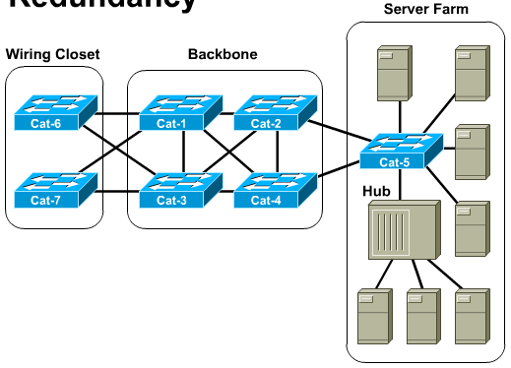
Good, Bad, and Ugly of Redundancy
Newer switched networks include redundant links to increase reliability and reduce single points of failure.
With that comes the potential for data loops.

Slide 4
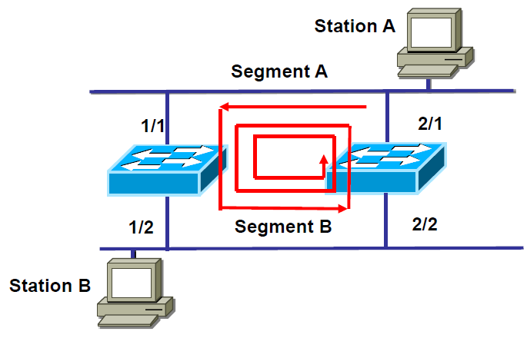
What is a Switching Loop or Bridge Loop?
Loop will occur any time there is a redundant path or loop in the Layer 2 network

Slide 5
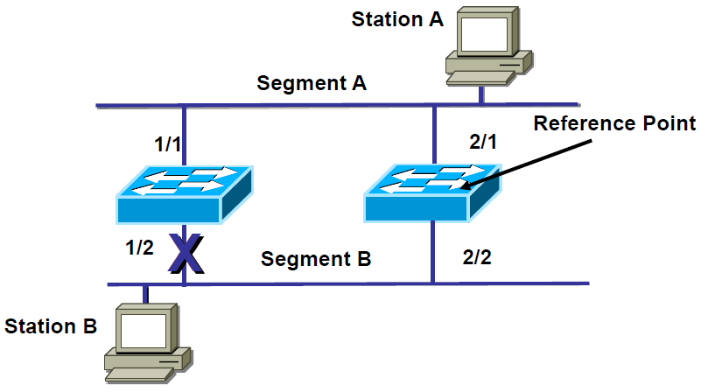
Spanning Tree Protocol (STP)*
* IEEE 802.1D Standard
Loops are prevented by blocking the redundant path
Uses Spanning Tree Algorithm
Blocked link opens up if forwarding link fails

Slide 6
Another Look
* CAM entries time out after 300 seconds inactive
A
Traditional Design
A
Redundancy Design
1 of 45
4th Floor
1 of 45
4th Floor
3rd Floor
3rd Floor
Core 1
Core 1
Router
Router
2nd Floor
2nd Floor
Core 2
1st Floor
1st Floor
No loops
Lots of single point failures
Lots of loops – looping will occur
CAM Table or MAC address flapping
Broadcasts trigger both

Slide 7
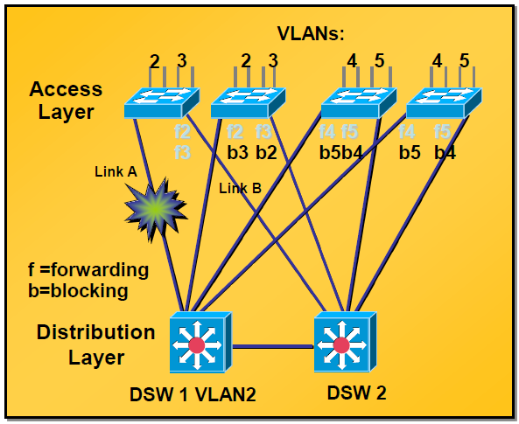
Ensuring Network Availability with VLANs
We want redundancy in LANs
To avoid orphan networks
To ensure availability
Spanning Tree
Blocks redundant link
With VLANs
Each link can forward one VLAN
Block the other

Slide 8
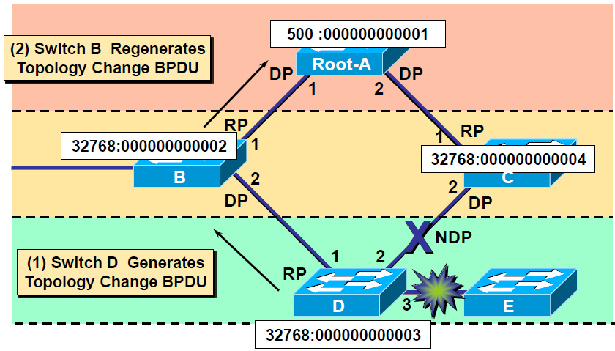
A Network Topology Change
Topology Change
Added device
Failed link or device
STP Election
Devices share BPDUs
Select blocked link(s)
Occurs automatically
Can be programmed
To control outcome
Bridge Protocol Data Unit (BPDU) – Data message transmitted across a LAN to detect loops in network topologies.

Slide 9
Fin…

